Slide 1
EDA on Hotel Booking Analysis
Capstone Project - 1
By Prathik Mane

Slide 2
Problem Statement
In this project we will be analyzing Hotel booking Data. This data set contains booking information for a city hotel and a resort hotel and includes information such as when the booking was made, length of stay, the number of adults, children, and/or babies, and the number of available parking spaces, among other things. All personally identifying information has been removed from the data.
The objective of this project is to explore and analyze the data to discover important factors that govern the bookings

Slide 3
WorkFlow
Data Collection and Understanding
Data Cleaning and Manipulation
Exploratory Data Analysis(EDA)
EDA is divided into following 3 analysis:
Univariate Analysis: It analysis each variable separately. It is possible for two kinds of variables- Categorical and Numerical
Bivariate Analysis: It analysis two variables and the relationship between them.
Multivariate Analysis: It analysis more than two variables.

Slide 4
Data Description
The dataset contains 119390 rows and 32 columns
Hotel: Type of Hotel(Resort Hotel or City Hotel)
is_cancelled: If the booking was cancelled(1) or not(0)
lead_time: Number of days that elapsed between the entering date of the booking into the PMS and the arrival date
arrival_date_year: Year of arrival date
arrival_date_month: Month of arrival date
arrival_date_week_number: Week number for arrival date
arrival_date_day: Day of arrival date
stays_in_weekend_nights: Number of weekend nights (Saturday or Sunday) the guest stayed or booked to stay at the hotel
stays_in_week_nights: Number of week nights (Monday to Friday) the guest stayed or booked to stay at the hotel
Adults: Number of adults
Children: Number of children
Babies: Number of babies
Meal: Kind of meal opted for
Country: Country code
market segment: Which segment the customer belongs to

Slide 5
Data Description
Distribution_channel: How the customer accessed the stay- corporate booking/Direct/TA.TO
is_repeated_guest: Guest coming for first time or not
previous_cancellation: Was there a cancellation before
previous_bookings: Count of previous bookings
reserved_room_type: Type of room reserved
assigned_room_type: Type of room assigned
booking_changes: Count of changes made to booking
deposit_type: Deposit type
agent: Booked through agent
days_in_waiting_list: Number of days in waiting list
customer_type: Type of customer
required_car_parking: If car parking is required
total_of_special_req: Number of additional special requirements
reservation_status: Reservation of status
reservation_status_date: Date of the specific status

Slide 6
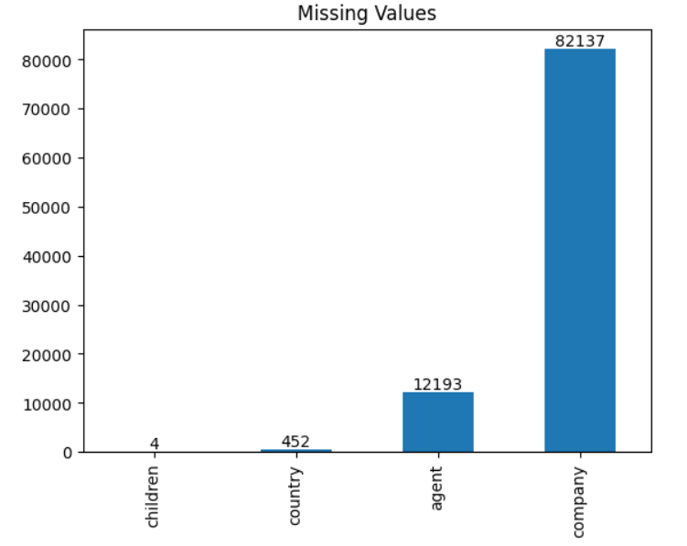
Data Cleaning and Manipulation
Given dataset has 31994 duplicates, which were dropped using drop_duplicates())
dataset has missing values in it . Children has 4 missing values, country has 452 missing values, agent has 12193 missing values, company has 82137 missing values.
As "company" has 93.98% missing values & "agent“ has 13.95% missing values so dropping these columns
As "children" has just 4 missing values out of 87396 and "country" has just 452 missing values out of 87396, so we can drop the respective rows

Slide 7
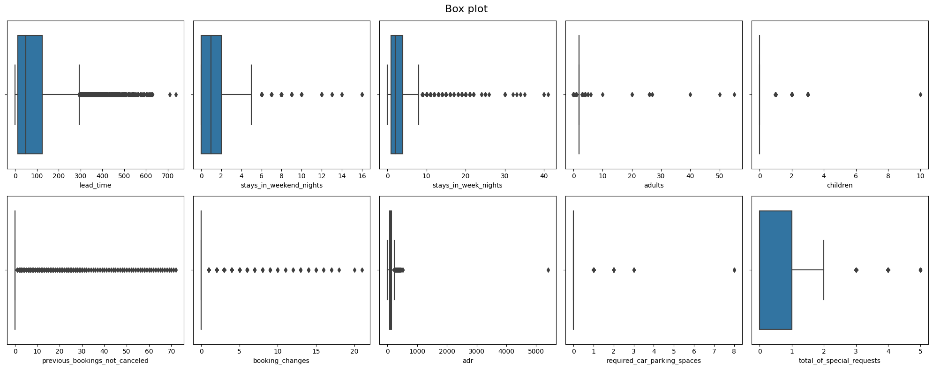
BoxPlot

Slide 8
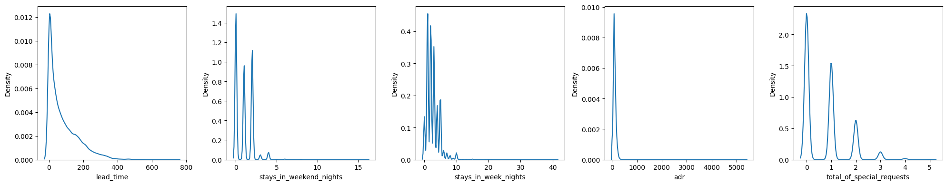
Skewness
As the data has skewed distribution, therefore using Capping & Percentile Method for outlier removal

Slide 9
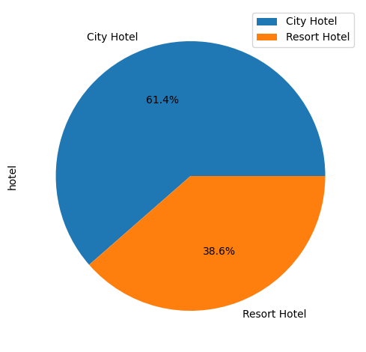
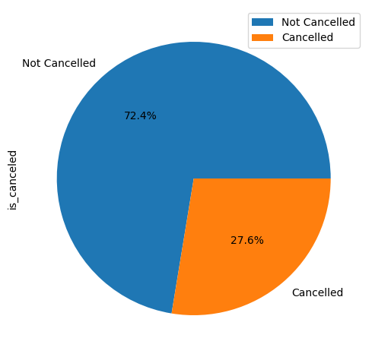
EDA
City Hotel is most preferred hotel type. 61.4% bookings were made for city hotel, which states city hotels are busier than Resort Hotel
27.6% of the bookings were cancelled

Slide 10
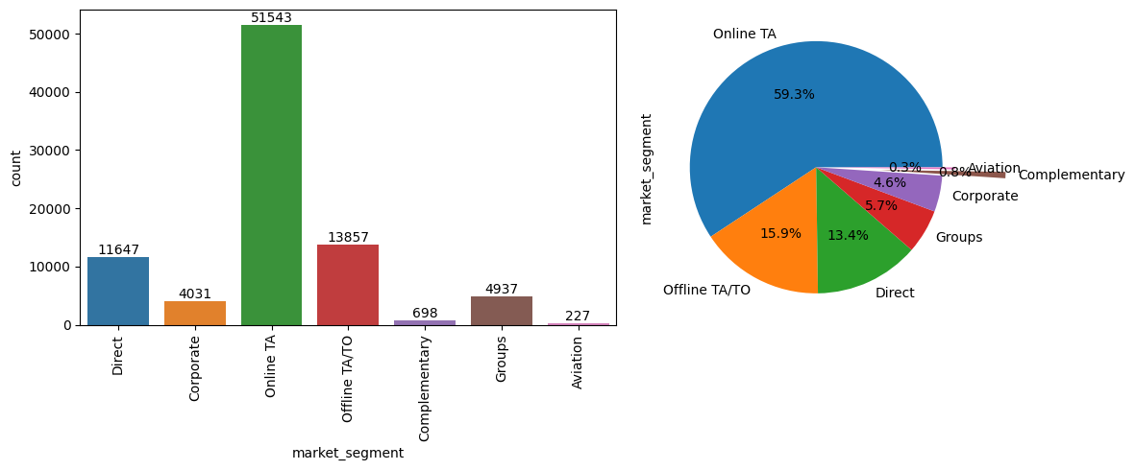
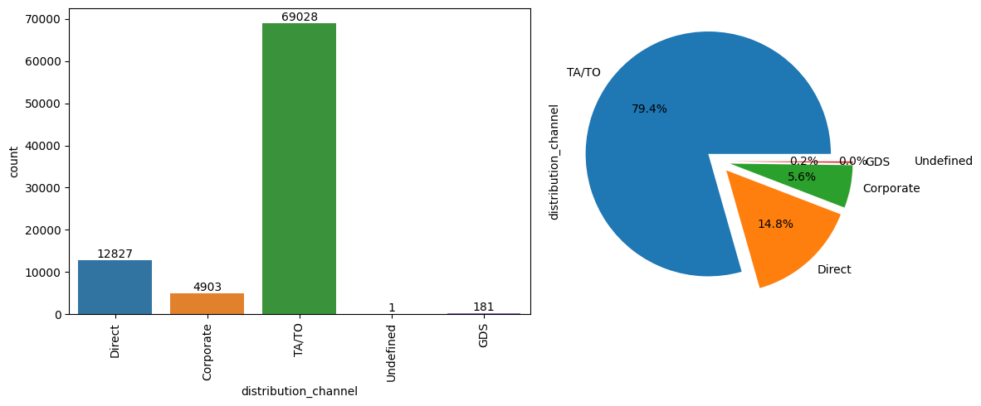
With online TA(Travel agents) Contributing to over 59.3% of the bookings while Corporate, Complementary & Aviation Contribute less than 5% of the bookings
TA/TO Distribution channel contributed most to the bookings of hotel.ie 79.4% of the bookings were made via TA/TO
Second most preferred distribution channel is Direct

Slide 11
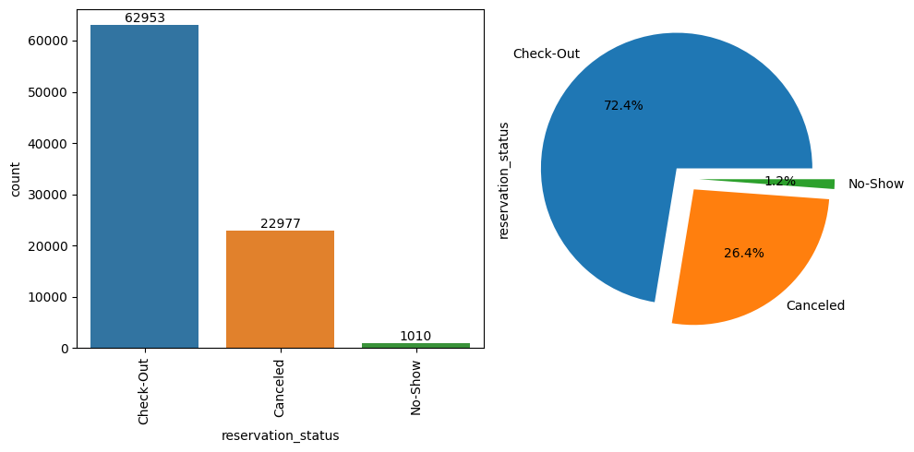
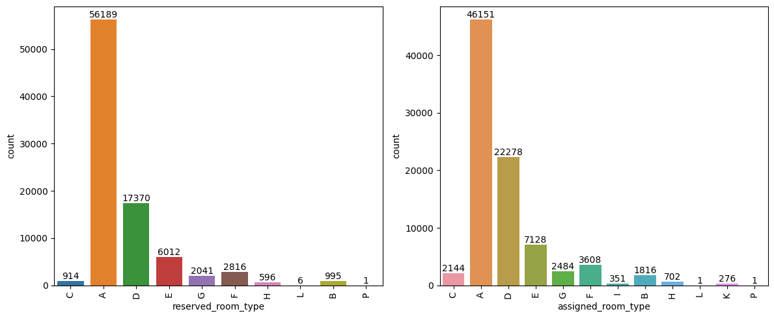
Less than 2% of the visitors didn't show up, majority(72.4%) of them checked out of hotel, while 26.4% visitors cancelled their bookings
Room Type ‘A’ is most preferred by visitors followed by room type ‘D’
We can observe that there is difference respective categorical count values in "reserved_room_type" and "assigned_room_type", that means not all customers were assigned the same room as they reserved

Slide 12
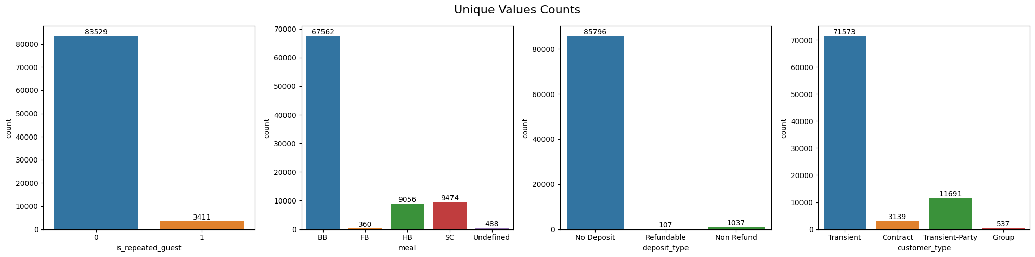
BB is most preferred type of meal followed HB and SC which are equally preferred
FB is least preferred meal
Most of the guests were not repeated, thus very low retention rate as they don't prefer the same hotel to stay again
Guest preferred "No deposit" over Non-refundable deposit
Also, most of the guest were Transient Type, followed by Transient-Party
Contract - when the booking has an allotment or other type of contract associated to it
Group - when the booking is associated to a group
Transient - when the booking is not part of a group or contract and is not associated to other transient booking
Transient-party - when the booking is transient, but is associated to at least other transient booking

Slide 13
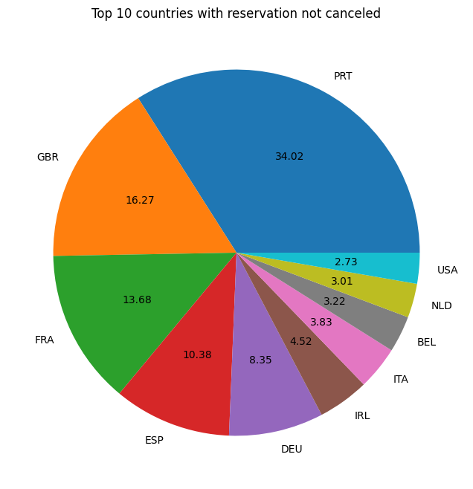
Most of visitors were from Portugal
After Portugal, Great Britain, France, Spain were the countries from where most visitors visited
Top 10 countries from where visitors came were majority European countries
PRT: Portugal
GBR: Great Britain
FRA: France
ESP: Spain
DEU: Germany
IRL: Ireland
ITA: Italy
BEL: Belgium
NLD: Netherland
USA: United States of America

Slide 14
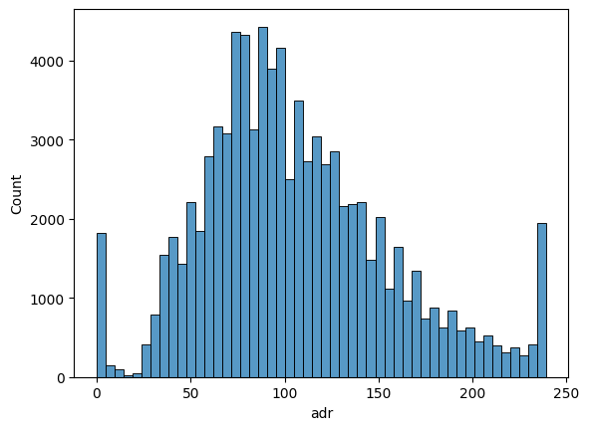
Average Daily Rate(ADR) measures the average rental revenue earned for an occupied room per day.
Most of the ADR is around 100, but there is sudden spike near 0 ADR stating zero occupancy

Slide 15
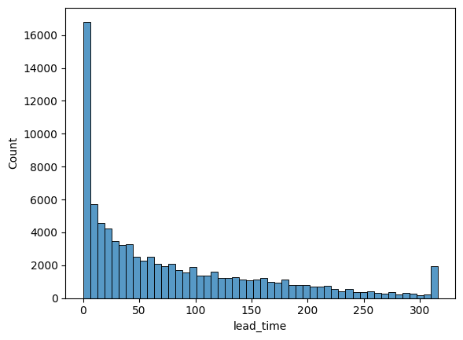
Lead time measures the number of days that elapsed between the entering date of the booking into the PMS and the arrival date.
Most of the people are booking very close to arrival date
Very few people book hotel very early before arrival date

Slide 16
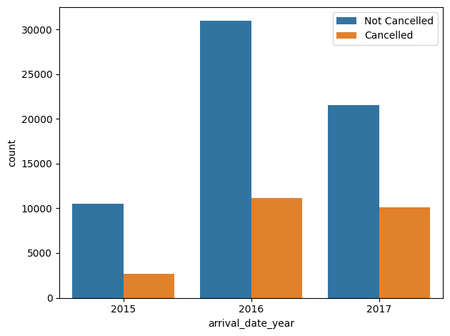
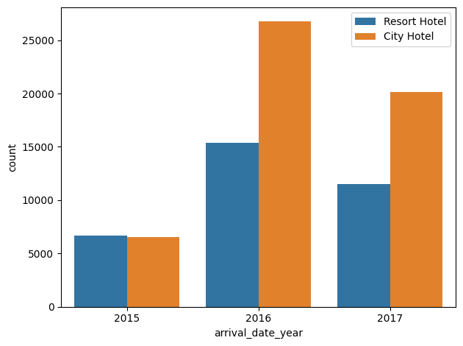
2016 year saw maximum bookings with booking cancellations similar to year 2017
2015 has very less bookings compared to 2016 and 2017
In 2015, similar number of bookings were done for Resort Hotel and City Hotel, and in 2016 and 2017 majority of the bookings were done for City Hotel

Slide 17
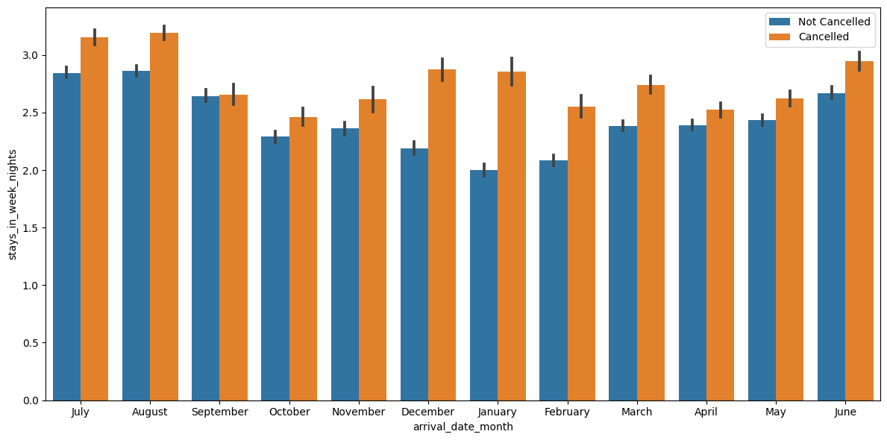
In every month, for weeknights the number of cancellation were more than the number of bookings not cancelled
Usually, guests prefer to stay 2 or more weeknights

Slide 18
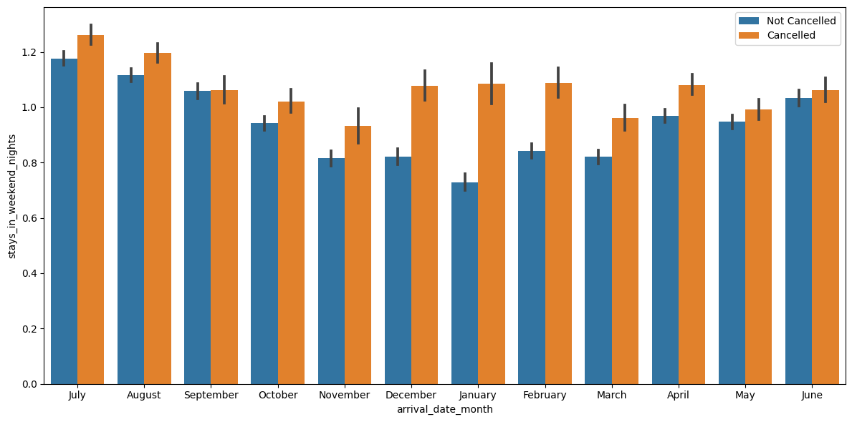
In December and January, comparatively more bookings were cancelled for weekend nights than any other month

Slide 19
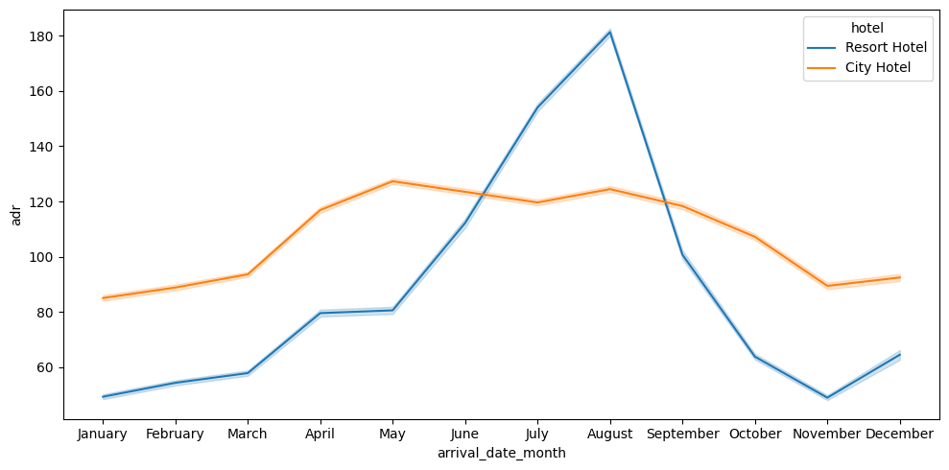
Prices(ADR) for Resort Hotel steeply increases from May to August and then decreases from September to November
Prices(ADR) for City Hotel on an average remains steady as compared to Resort Hotel

Slide 20
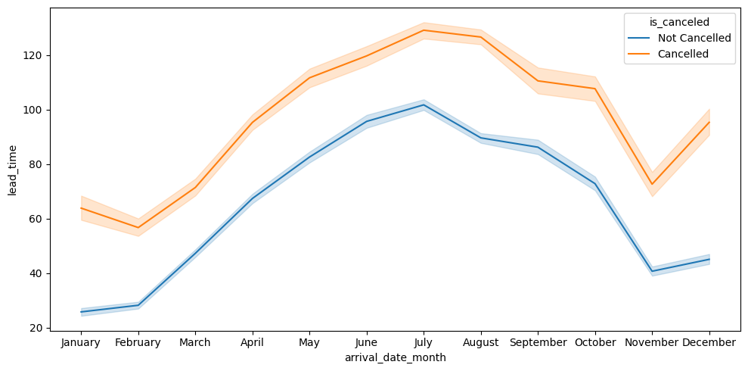
June, July and August have higher lead time as compared to other months
As the lead time increases, chances of cancellations also increase

Slide 21
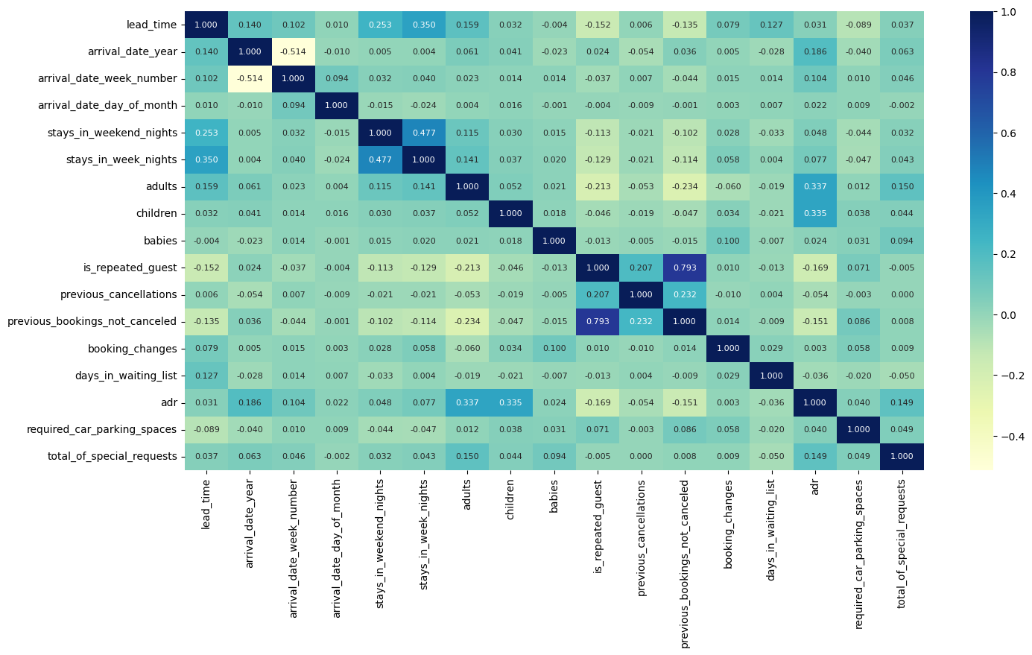
is_repeated_guest and previous_booking_not_canceled are highly correlated(0.793), means if the previous bookings are not cancelled then there are high chances that the guest might visit again
stay_in_week_nights and stay_in_weekend_nights are positively correlated, means if there are more guests visiting in weeknights, then there is high chance that more number of guest will be visiting in that coming weekend night
Adults and children are positively correlated to ADR, means if more number of guests book the hotel, then prices of hotel booking might increase

Slide 22
Conclusion
City Hotel is most preferred hotel type. So, city hotels are busier than Resort Hotel
Online TA(Travel agents) Contributes to over 60% of the bookings and TA/TO being the most preferred Distribution channel.
Room Type ‘A’ is most preferred by visitors
Not all customers were assigned the same room as they reserved.
Less than 2% of the visitors didn't show up, majority of them checked out of hotel, while 26% visitors cancelled their bookings
BB is most preferred type of meal.
Most of the guests were not repeated, thus very low retention rate as they don't prefer the same hotel to stay again
Guest preferred "No deposit" over Non-refundable deposit
Also, most of the guest were Transient Type
Most of visitors were from Portugal
Top 10 countries from where visitors came were majority European countries
Most of the people are booking very close to arrival date, Very few people book hotel very early before arrival date
2016 year saw maximum bookings with booking cancellations similar to year 2017
In every month, for weeknights the number of cancellation were more than the number of bookings not cancelled
Usually, guests prefer to stay 2 or more weeknights
In December and January, comparatively more bookings were cancelled for weekend nights than any other month
Prices(ADR) for Resort Hotel steeply increases from May to August and then decreases from September to November
June, July and August have higher lead time as compared to other months
‘is_repeated_guest’ and ‘previous_booking_not_canceled’ are highly correlated(0.793), means if the previous bookings are not cancelled then there are high chances that the guest might visit again
Adults and children are positively correlated to ADR, means if more number of guests book the hotel, then prices of hotel booking might increase

